Slide 1
The Wonderful World of Tools Programming
Or how I learned to stop worrying and love C#
By Sean Boocock

Slide 2
Topics
Background
CPUT framework
CPRT file format
Tool development
Humble beginnings
Model Viewer
CPRT conversion interface
CPRT contributions
Personal projects

Slide 3
Bit About Me
Dreamt of being a physicist
Double majored in math and physics at Georgetown University
Realized I didn’t want to be a physicist, an academic one at least; the philosophy of physics sounded more appealing
Spent a year and a half in Notre Dame’s History and Philosophy of Science PhD program
Realized I didn’t want to be an academic, period.
Had loved prior experience programming and gaming was a lifelong hobby hence…
Going into my last semester in USC’s Masters in Computer Science program, specializing in Game Development

Slide 4
Background: Existing Samples Framework
The GTD team has used DXUT targeting DirectX11 and DirectX10 (as DX11 with the Directx10 feature level selected) with limited exceptions
The primary file format has, in keeping with the DXUT framework, been SDKMesh.
SDKMesh is a fairly simple though inextensible format that supports most of what one need for samples.
Limited animation support through separate animation file
Notes:
*works well enough
*developers know DX
*but………..

Slide 5
Background: CPUT Motivation
Remove dependencies
Control the framework. New features easier to implement at the framework level. Can tailor the framework for current and future samples.
Platform independence not abstraction
A little birdie told me about OpenGL, Android, OpenGL ES 2.0…
Use a common API that still exposes platform specific conventions. Target different platforms without having to rewrite significant portions of a sample.
Notes:
*You’re tied to DirectX and specifically DXUT as a framework. Limits possibilities
*If you wanted to port your sample, good luck.
*But porting is going to be increasingly important. Atom, android, tablets, they all mean opengl/es will be future sample targets.
*So abstract the platform
*But not too much. Preserve API specific features while making utiltity (ie the UT in DXUT) cross platform

Slide 6
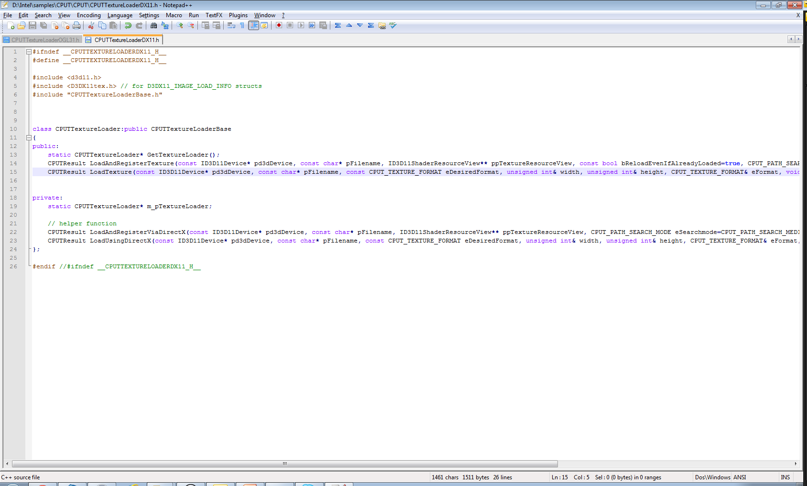
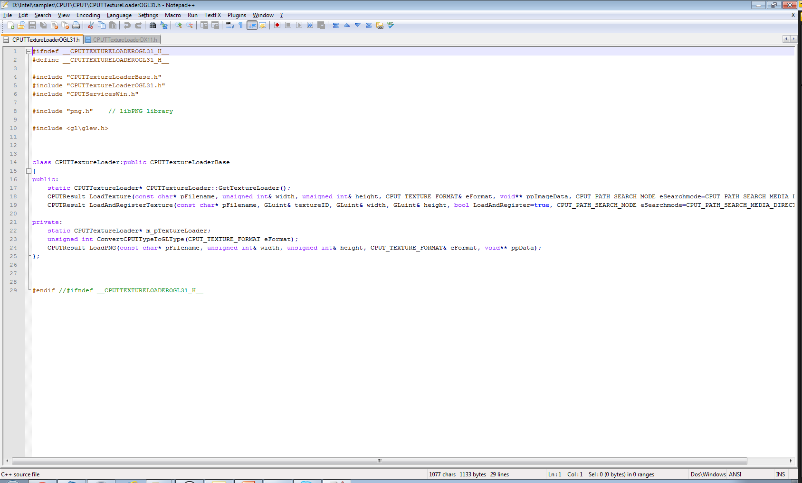
Background: CPUT
DirectX
OpenGL
Notes:
So as an example, TextureLoading has an almost identical API for the DX and OpenGL variants, with differences accounting for conventions of each API.

Slide 7
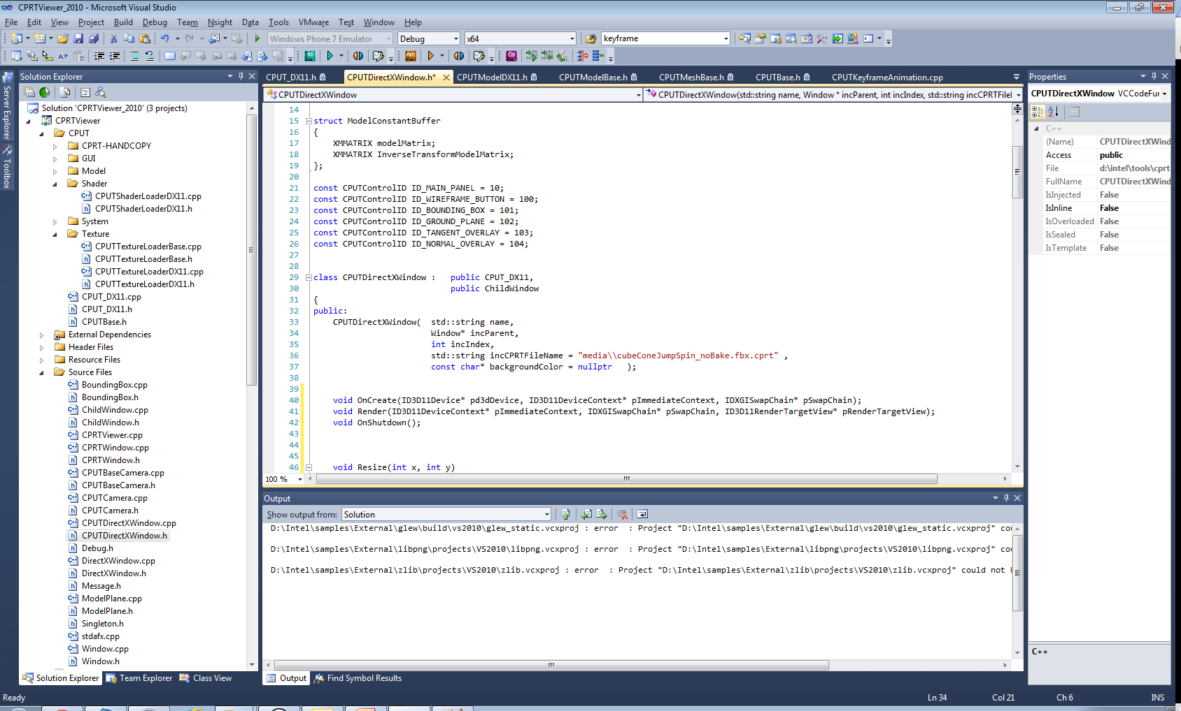
Background: CPUT
Anatomy of a sample
Inherit from CPUT_DX11 (or
CPUT_OG31)
Overloaded virtual methods
that drive sample execution
Notes:
So ok, how do you go about writing a sample in CPUT? You start out by first deriving a main, driver class from either CPUT_DX11 or CPUT_OG31. You then have access to three important callbacks that will drive the execution of your sample…

Slide 8
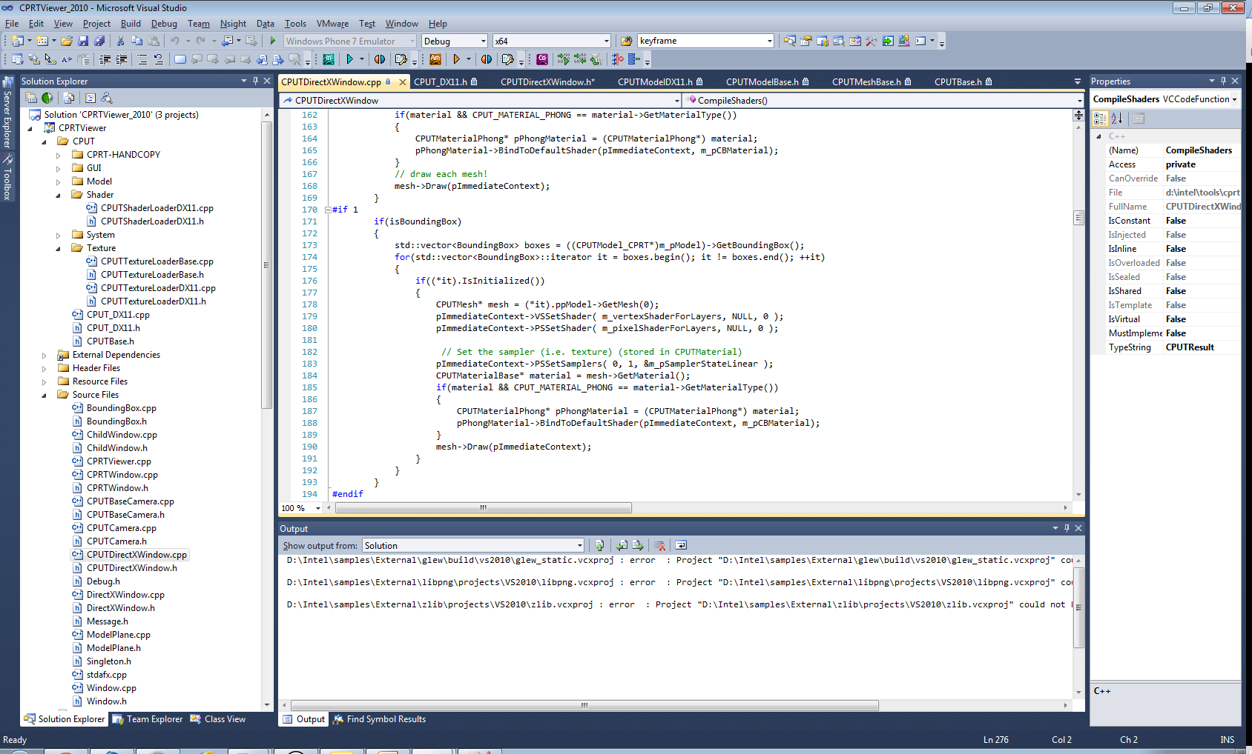
Background: CPUT
Quality of life/utility features
Easy to use simple GUI system
Shader reflection
Combining framework and direct API calls
Notes:
*In addition to limited platform abstraction and common utility api, some other features of CPUT are a very easy to use GUI system that can reproduce any of the common DXUT controls and some quality of life features like advanced error detection.
* This is an example of typical code you might see in the render loop of a CPUT sample. It blends CPUT calls with direct API calls (ie setting shaders/samplers)

Slide 9
Background: CPRT
So we have a new framework. Now we need a way to handle assets…
SDKMesh drawbacks:
Tied to DirectX
Inextensible; limited feature set
Enter CPRT
Modular, heavily templated architecture
Easy to add support for new assets in the future
Notes:
*Transitioning now to some background on CPRT, CPRT is the file format powering the new framework. CPRT is a few different things including the file format and some tools for converting/loading it of which my user interface is a component.
*File format itself is impressive. Very modular design with loose coupling between components. Designed to make adding new features (ie types of assets) painless.

Slide 10
Background: CPRT
CPRT
a 1
200 1 1 255 1 0 0 0 # header info for Model
Asset 1
# (6 elements in array)
2 3 4 5
6 7
end # end of array data
300 2 1 255 0 0 1 0 # header info for BoundingVolume
6
0.5 0.5 0.5 -0.5 -0.5 -0.5
end # end of array of data
2 3 1 14 1 0 4 3 # header info for Vertex Data
POSITION
# (108 elements in array)
File Header
Model Asset Header
Model Asset Data
Bounding Volume Header
Bounding Volume Data
Position Asset Header
Position Asset Data
Normal Asset Header
Normal Asset Data
…
Notes:
*Here is an actual example of a CPRT file on the left and its logical representation on the right.
*Header,data,header,data design with assets coming in arbitrary order

Slide 11
Tool Development: The beginning
My own software background
Been exposed to a fair number of languages and environments but primarily a C++/C programmer
Never written tools, but appreciated good ones
Initial ideas/design
What language to use for interface?
Native C++ with MFC
C#
How to integrate model viewer?
Language would dictate how this interaction would work.
Notes:
*So with that out there, let me transition to my work here over the summer. My project was to make a graphical user interface that facilitated the FBX conversion process and allowed the user to see the resulting model in a sample CPUT environment.
*My own background is in mostly C/C++ but I’ve been exposed to everything from python and perl for server side scripting to ios and android development.
*” If you do want to go back to build a Windows C++ application how should you create the UI? At the moment you can pick between the MFC - huge and unwieldy, the ATL - easy to use but difficult to understand, the raw Win32 API, or a third party framework like Qt. Compared to the support that a .NET language gets from Windows forms or WPF this is not good.” (http://www.i-programmer.info/professional-programmer/i-programmer/2830-was-net-all-a-mistake.html)

Slide 12
Tool Development: Early Steps
Decisions
Use C# for file conversion interface (which meant learning C# as I went)
Write model viewer as separate tool using IPC to communicate between the interface/model viewer
IPC conundrum
Clipboard? Memory mapped file? TCP/IP?
Used WM_COPYDATA

Slide 13
Process 1
Process 2
SendMessage(hWnd, WM_COPYDATA,
NULL,
message)
Message Pump
{ …
case WM_COPYDATA:
Bingo!
break;
… }

Slide 14
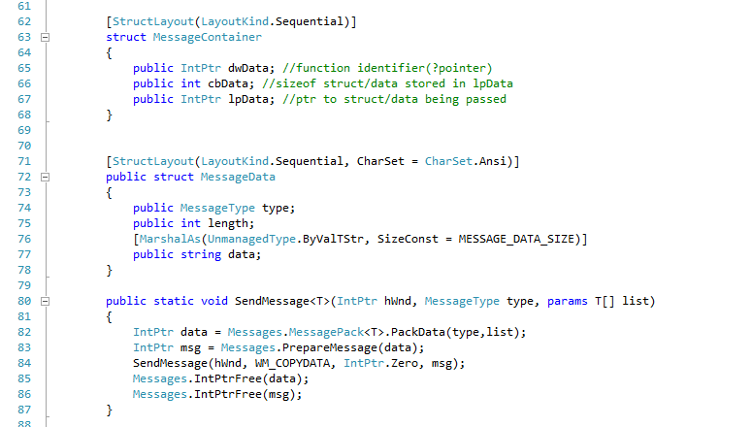
Tool Development: Early Steps
WM_COPYDATA and messaging system
Message goes here
WM_COPYDATA struct
Have to be careful with reference types
Notes:
*What’s the message? The message looks like this, at least in c#
*Issues:
**character encoding if sending strings
**memory layout of structs on both ends

Slide 15
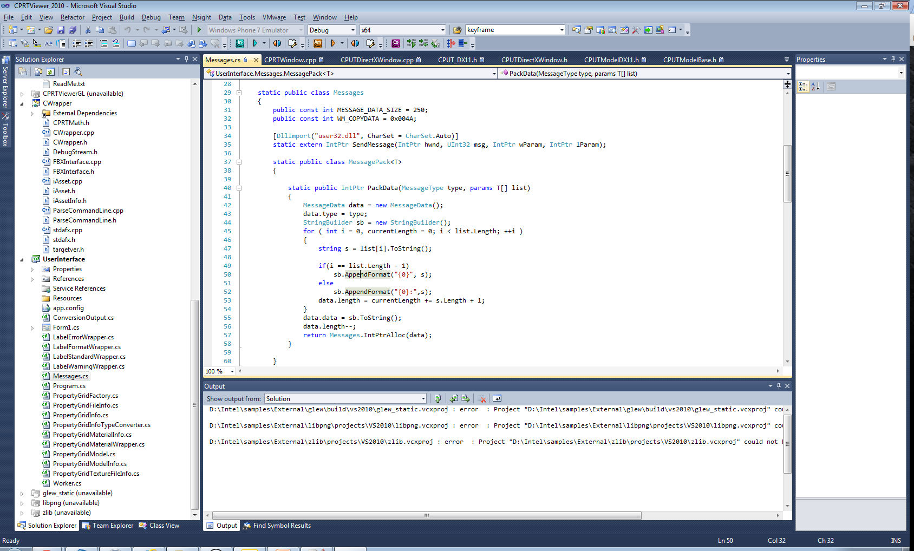
Tool Development: Early Steps
Pack data into : delimited string
Pinvoke – The other way to interact with native code

Slide 16
Tool Development: Early Steps
Model viewer windowing system
First prototypes with standard DirectX rendering loop implementation
Wouldn’t it be cool to be able to compare side-by-side the CPUT implementations of OpenGL and DirectX?
Parent window containing multiple child windows

Slide 17
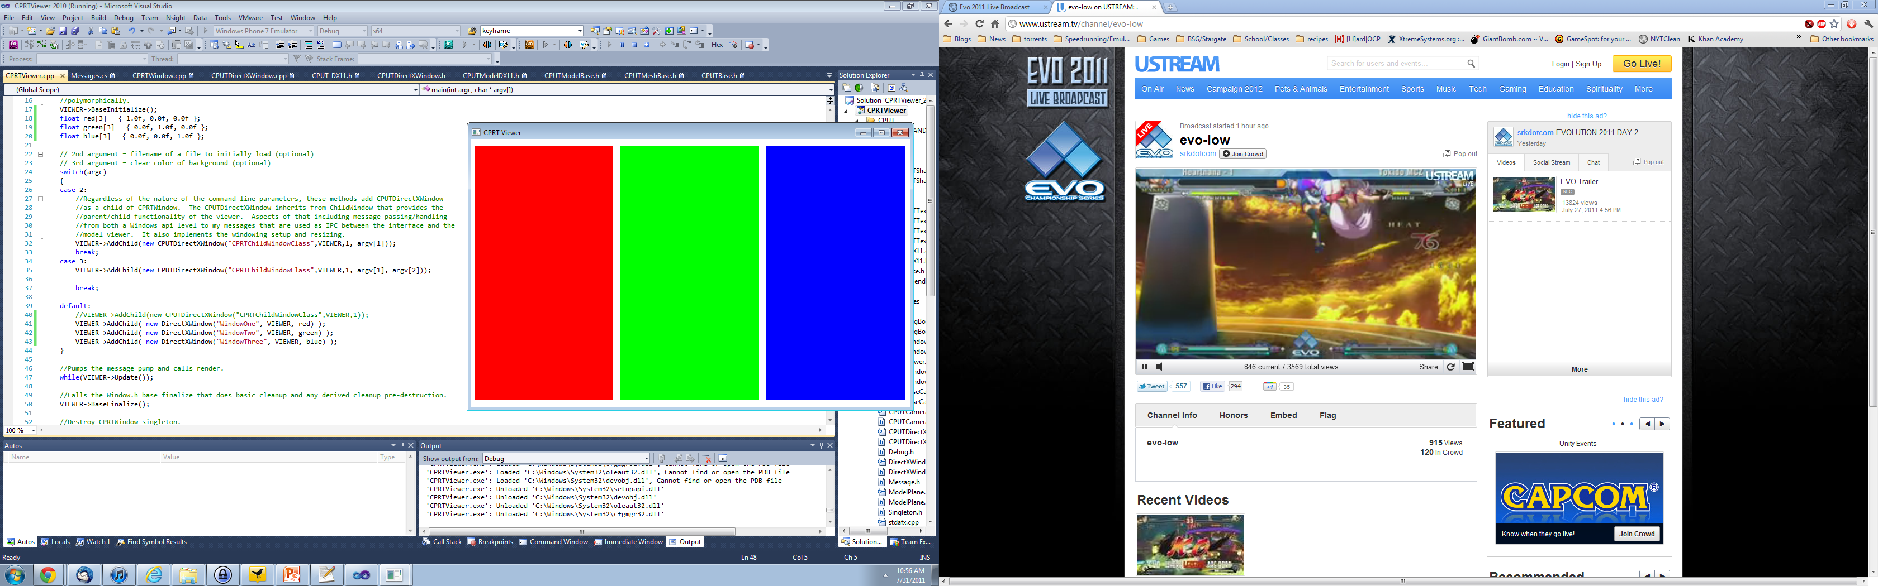

Slide 18
Tool Development: Building a CPUT sample
Model viewer is essentially first CPUT sample
Uses the established framework with limited additional lower level access to allow for windowing system.
Also subclass certain classes (CPUTModel) to get easier access to vertex streams. Useful when generating mesh overlays for normals/tangents.

Slide 19
Tool Development: Model viewer features
Developed basic camera system
Free rotate around targets with mouse look
WASD movement controls
Caching system to minimize matrix generation
Interfaces with other systems/objects for automatic scaling/pick ray

Slide 20
Tool Development: Model viewer features
Two implementations of pick ray model selection
Both based on simple axis aligned bounding box that I implemented in CPRT
Simpler bounding sphere
More accurate (and default) bounding box implementation
Notes:
Either demo or add pictures of the parent cubes model.

Slide 21
Tool Development: Model viewer features
Automatic asset generation
Fault tolerant asset loading; tries as hard as possible to load an asset if it has the bare minimum needed to render.
Delays registering of assets to inspect/determine what is missing relative to what the default shader expects. Adds dummy data as necessary to get asset to load/render.
Informs user of what assets were generated.

Slide 22
Tool Development: Model viewer features
Bounding box, ground plane, and automatic scene scaling
Bounding box implemented in CPRT and displayed as a line list model
Ground plane that scales with the model size as determined by the bounding volume
Automatic adjustments include: scaling camera position/clip planes, scaling the ground plane, and adjusting mouse camera movement constants

Slide 23
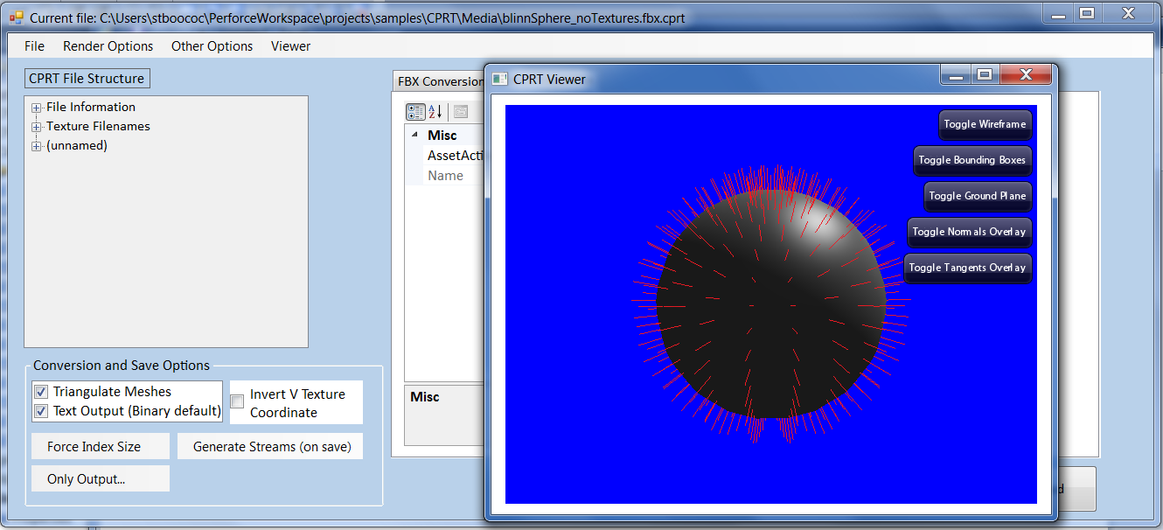
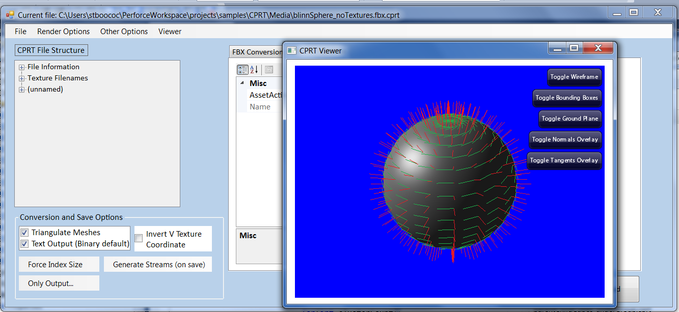

Slide 24
Tool Development: Model viewer features
Vertex stream overlays
Normals and Tangents
Implemented as separate (CPUT)models generated during model loading.
Rendered as DX line lists scaled to model size
Notes:
Include pictures

Slide 25
Tool Development: Model viewer features
Animation system (CPUT side)
Keyframes
LERPs translation/scalar components of a vector of keyframes based on time
SLERPs quaternions for correction rotational interpolation
“Onloaded” skinning
Bones based animation on the CPU implemented by mapping dynamic vertex buffers
Iterates over bones, adding transformations scaled by weight

Slide 26
Tool Development: Model viewer features
Lets take a look…
Notes:
*Demo vorp model animation, starting model viewer by itself.

Slide 27
Tool Development: CPRT interface early steps
C# and native C++: not the best of friends
First experiments with compiling FBXInterface as . Dll and using pinvoke to access data
Better solution: managed C++ as interface with native code
Managed C++ wraps all direct calls to native code/objects.
C# can directly call/use managed C++ functions/most objects

Slide 28
Tool Development: CPRT interface early steps
First technical hurdle/feature request: text output of conversion process
Simple to grab std::out and pipe it elsewhere, right? Not so fast…
Struggled to capture std::out or OutputDebugStream of native code execution
Alternative solution
Series of function pointers to serve as callbacks ferrying strings from the conversion output back to C# interface where it is formatted based on warning level

Slide 29
C#
C++ w/CLR
C++
Create conversion output delegate
Convert delegate to native function pointer using interop
Set function pointer in custom stream class
Receive output and invoke second delegate to run on textbox owning thread
While converting, send back 16 char chunks of output
Format and display output to the screen via textbox

Slide 30
Tool Development: CPRT interface features
Interaction with model viewer
Open/close
Live updates as you edit/load files in the interface
Flexible message passing to send commands
Change background/clear color
Load files as they’re converted/edited
Easy to add future support for other interaction

Slide 31
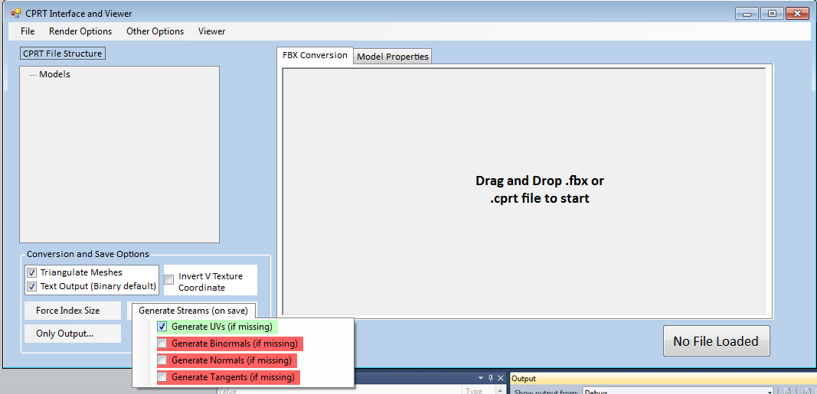
Tool Development: CPRT interface features

Slide 32
Tool Development: CPRT interface features
GUI interface on FBX conversion utility
Open CPRT or FBX file
Ability to set all supported command line options with intuitive menus
Drag and drop/file dialogs
Formatted conversion output akin to console output with dialog boxes (by default; option to suppress) confirming successful conversion or presence of an error

Slide 33
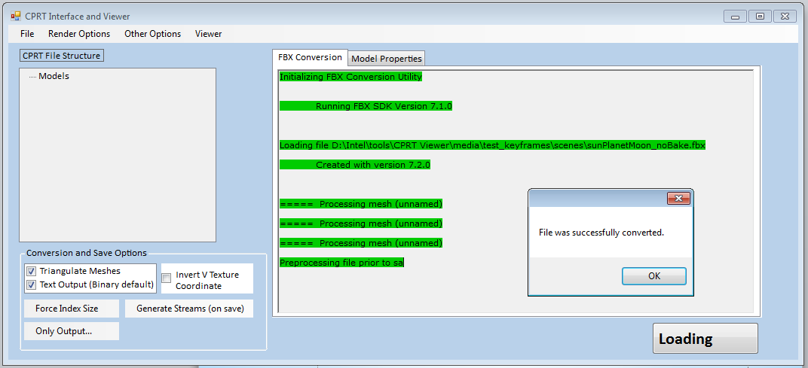
Tool Development: CPRT interface features

Slide 34
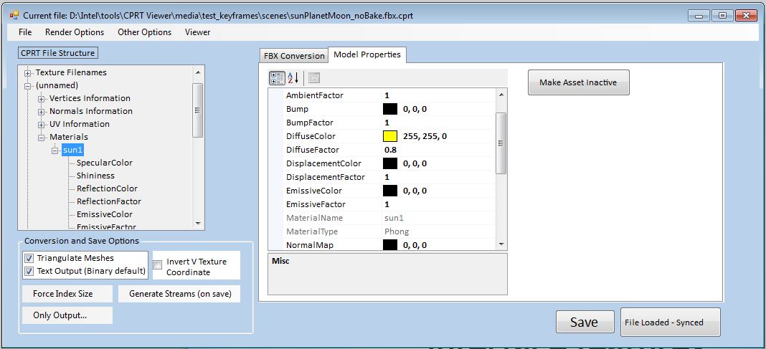
Tool Development: CPRT interface features

Slide 35
Tool Development: CPRT interface features
Tree view of converted CPRT file
Hierarchal list of all file assets indicating current state
This combined with the property grid view was one of the hardest interface specific features to implement.
Tree view (C#) recursively built from PropertyGrid (C#) objects that are recursively built from iAssetInfo (managed C++) objects that are constructed by parsing a flat vector of iAsset (native C++) from CPRT

Slide 36
Tool Development: Detour
C# 3.0+ and LINQ
Really cool feature
var propertyGroups = from asset in info
group asset by asset.assetType into assetGroups
select new { AssetType = assetGroups.Key, Assets = assetGroups };
foreach (var group in propertyGroups)
{
…
foreach (var asset in group.Assets)
{
…
}
}
Notes:
No magic so to speak. Var isn’t a dynamic variable but something more akin to C++0x auto; the compiler will infer type at compile time. What LINQ primarily does is provide a lot of syntatic sugar on otherwise messy code using conventions that are already familiar to most. Type inference also makes this portable/extendable to somewhat arbitrary types.

Slide 37
Tool Development: CPRT interface features
PropertyGrid and live editing
Of material parameters
Series of callbacks/events defined to update the underlying, in-memory CPRT data of the C# interface abstractions
Non trivial to implement safely. What the user sees and interacts with is far removed from the actual data. Must be able to prevent edge cases (ie editing parameter while another file is loading)
Of textures

Slide 38
Tool Development: CPRT interface features

Slide 39
Tool Development: CPRT interface features
PropertyGrid and live editing
Of textures
Add textures to any supported material property (normal maps, ambient occlusion maps, etc). Interface does the relative path handling automatically and prompts you on override attempts.
Know better? Edit the path names directly.
Live editing
Default behavior reloads CPRT files as they’re edited in memory, also refreshing the model viewer with the new assets.

Slide 40
Tool Development: CPRT interface features
Lets take another look…
Notes:
*Demo vorp model again. Converting it, loading it in model viewer, then editing diffuse color.
*Demo blinnsphere without textures. Add gravel textures then add rocky beach textures replacing them.

Slide 41
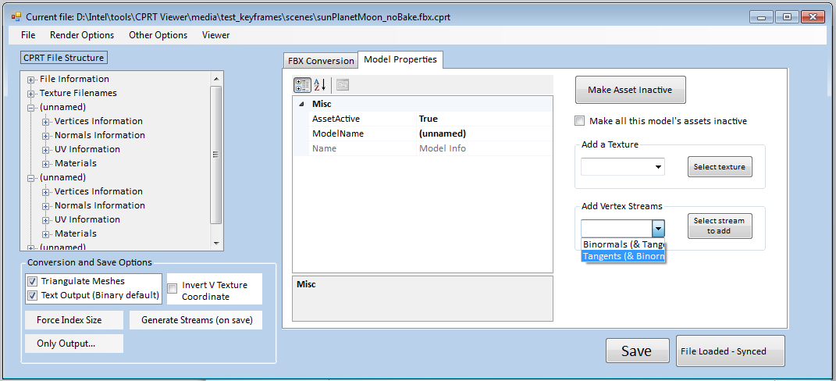
Tool Development: CPRT interface features

Slide 42
Tool Development: CPRT interface features
Asset conditioning/manipulation
Add vertex streams
Optionally add calculated normals, tangents and binormals after file load. Also implemented as a default FBX2CPRT conversion feature
Cull assets for export
Select assets via the tree view and make them “inactive”, removing them from the final CPRT file. Information for removed assets is retained though (with a visual indicator) so a user can see what has been removed from a file relative to its original contents

Slide 43
CPRT Contributions
Bounding Volumes
Calculated during conversion and added by default to all models
Normals/Binormals/Tangent generation
Calculated by default and added to models that are missing them

Slide 44
CPRT/CPUT Contributions
First pass implementations of the whole animation pipeline for both keyframe animation and bones-based animation
Generic keyframe animation parsing system for parsing animated FBX properties
LERP’d/SLERP’d keyframe animation of meshes in CPUT, now made available as part of the framework
Implemented with quaternions for accurate rotational matrix reproduction

Slide 45
CPRT/CPUT Contributions
Bones-based animation
Parse FBX skeleton/bones for per vertex bone weights and transforms per animated timestep.
On CPUT side, map to dynamic vertex buffers, updating each vertex with its new position as transformed by the weighted sum of bone transforms for that vertex
Lots of subtle issues from how to map bone weights given FBX’s internal handling of vertices to correctly interpolating all vertices during a looping animation

Slide 46
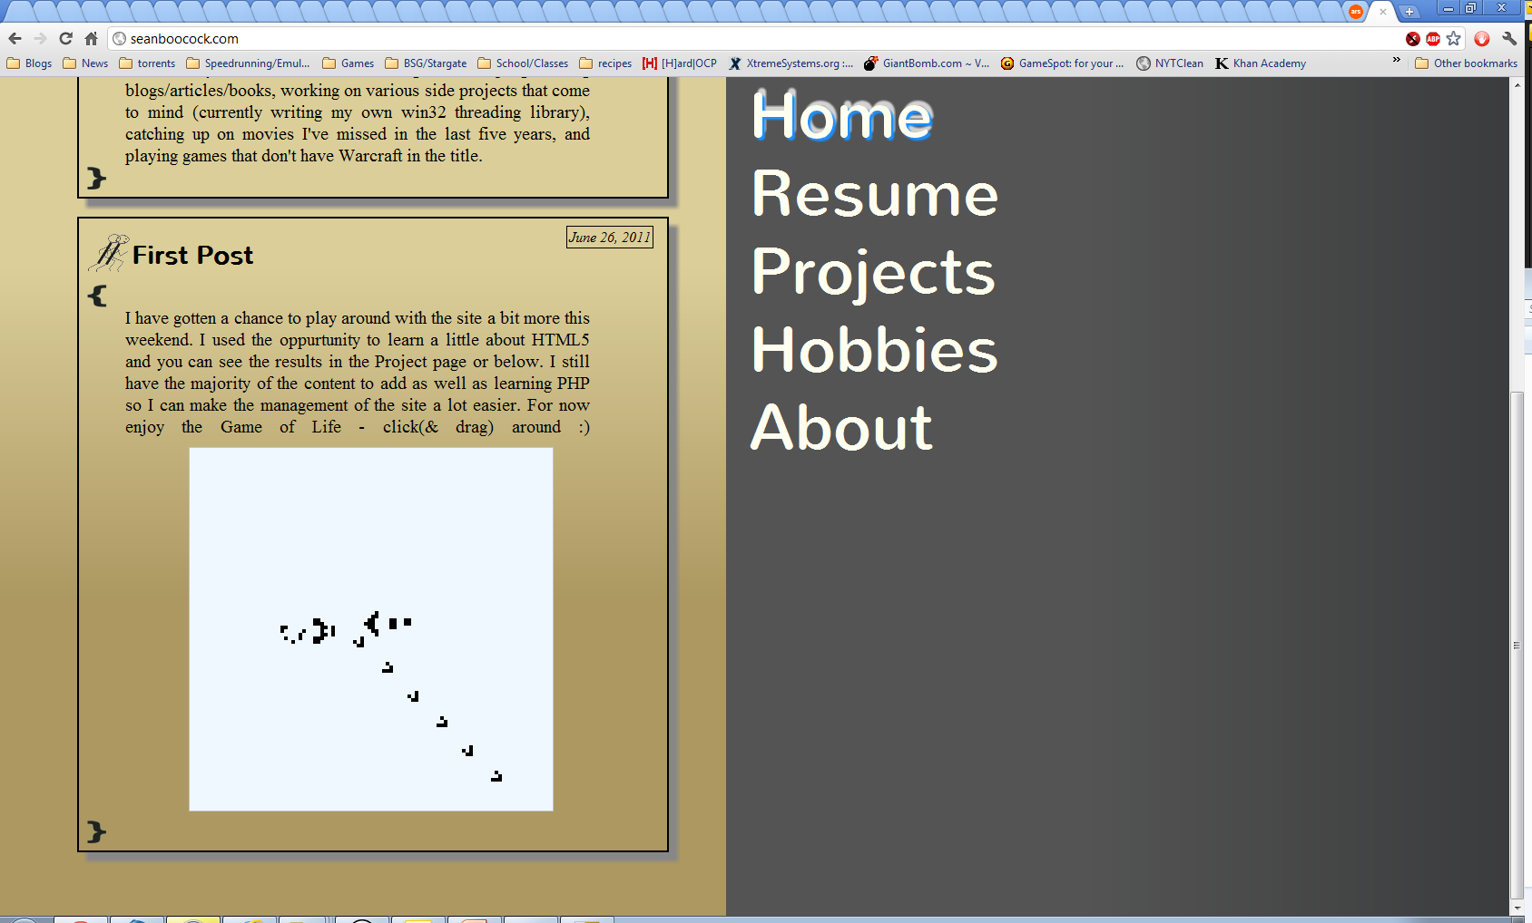
Personal Projects

Slide 47
Personal Projects
PHP/HTML 5
Developed a small PHP/MySQL based post management system for personal website as an exercise in learning both
Developed an HTML5 demo using the <canvas> tag and an interactive version of Conway’s Game of Life.
Expanding this as I have to time to implement functionality for my new site

Slide 48
Personal Projects
Workpool/Threading library
Wanted to get a better grasp of Win32 threads and workpool
Goal was to allow use of lambdas (and standard function pointers) to define tasks as well as implement conventions like parallel_for
Ended up implementing something like std::function
Work in progress

Slide 49
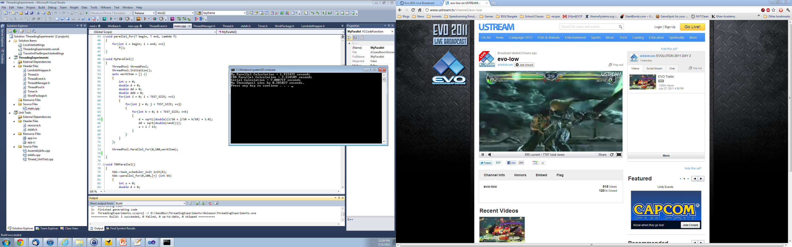

Slide 50
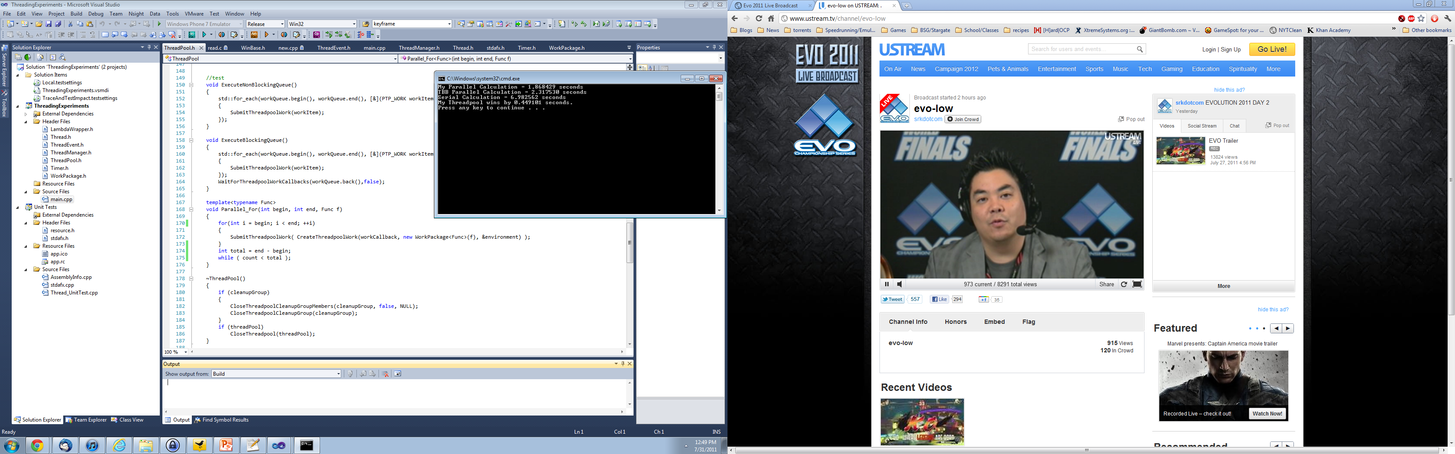

Slide 51
Personal Projects
SIMD optimized, multi-threaded software triangle rasterizer
Inspired by Doug Mcnabb’s chalk talk presentations on software quad/triangle rasterizers and EZSIMD
Opportunity to learn SIMD while revisiting software rasterization as a better coder

Slide 52
Personal Projects
Rendering pipeline
For each primitive
Transform vertices from model to screen space
Clip primitives to viewing frustrum
Sort vertices in clockwise order
Evaluate pixels via a Linear Expression Evaluation
Interpolate depth, normal, etc values at each included pixel, writing values into Gbuffers
For each screen space pixel
Calculate shading equation for pixel and write final color to be displayed

Slide 53
Personal Projects
Multithreaded design
Completely parallel execution with one major barrier demanded by the application of deferred rendering
Writing to G-Buffer(s) is major source of contention
Implemented via lockless algorithm using InterlockedCompareExchange
Still thinking about how best to schedule primitives; naïve parallel_for for now

Slide 54
Personal Projects
SIMD
Vectors and matrices typedefs of _m128s (ala XNAMath, Vmath and in keeping with Designing Fast Cross-Platform SIMD Vector Libraries (Gustavo Oliveira January 2010)
Vertex information kept as _m128s from initial load to writing into depth buffer/shader calculation
Use of instructions from SSE1-4

Slide 55
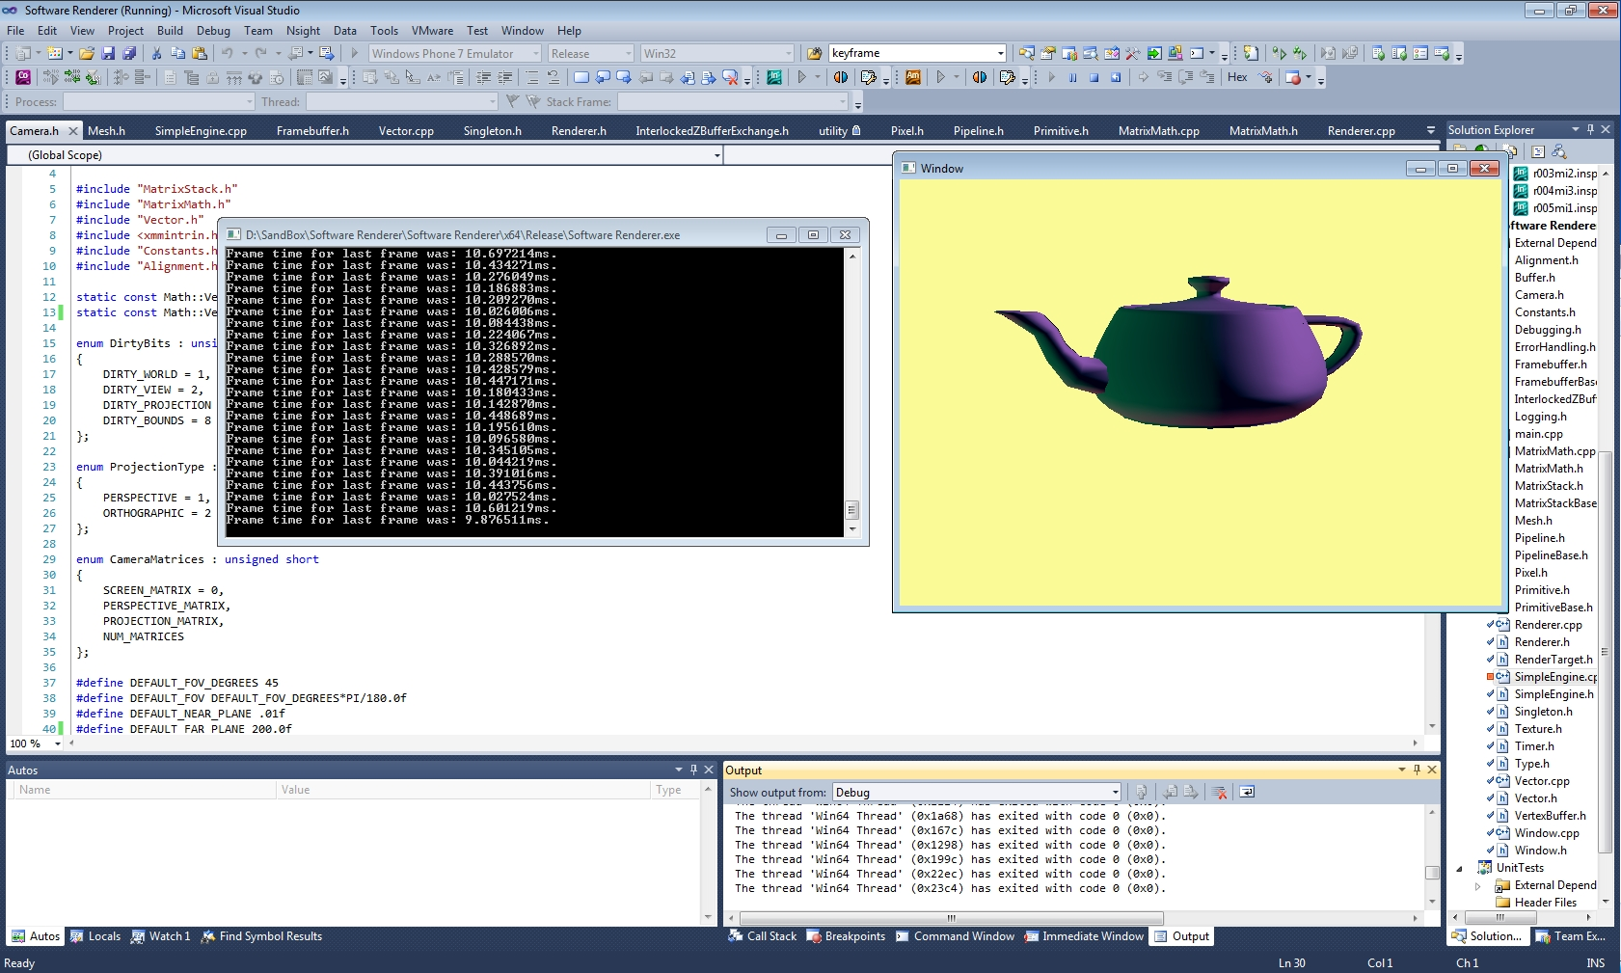

Slide 56
Q/A

Slide 57
Personal Projects
Other interesting bits
Render pipeline
Component of primitives that define render steps
Templated class; specializations define different steps (ie triangles vs quads)
Implemented as array of member function pointers of singleton render class. Primitives can walk, skip or sort this array as needed.

